Slide 1

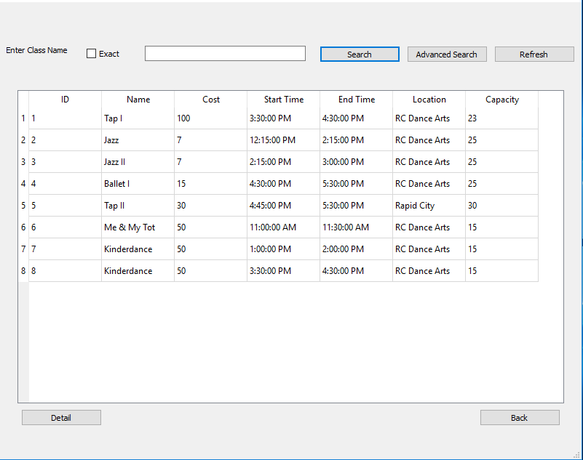
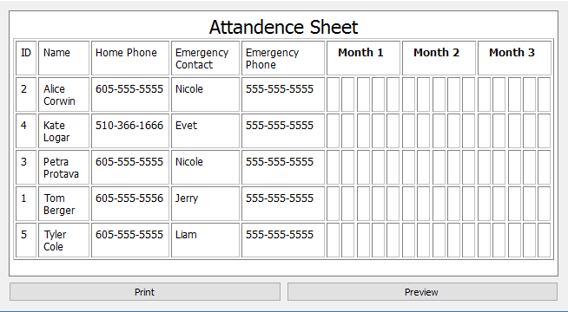
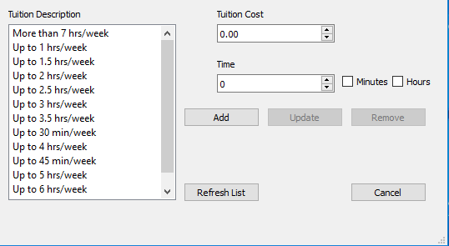
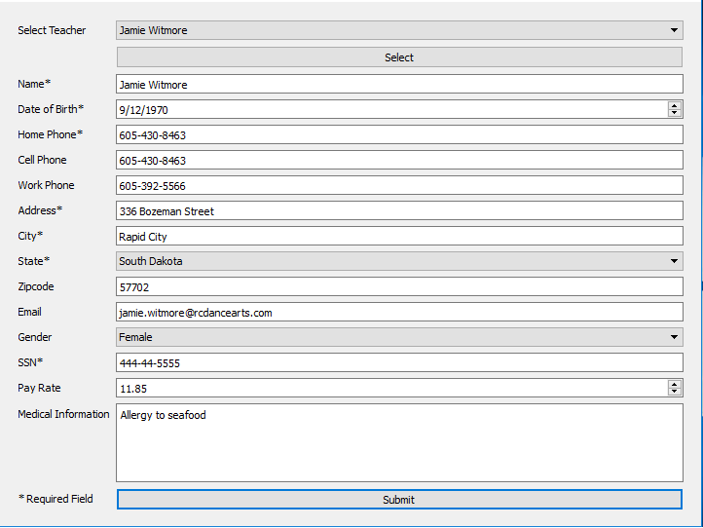
DanceSoft
Special Thanks
Brian Butterfield
Dr. Mengyu Qiao
Roger Schrader
Team Members: Marcus Berger and Dicheng Wu
Project Sponsor: Dr. Jeff McGough
User Interface
Project Overview
Academy of Dance Arts
The User Interface was created using PyQt 4. The overall goal was to create a simple yet effective user experience.
Our goal is to produce a simple and effective management tool to replace the outdated system currently in use at the Academy. This way the users spend less time at their computers, and more time teaching the wonders of dance.
The Academy of Dance Arts located in Rapid City and Sturgis, provides classes in a variety of dance styles to students of all ages. These classes range from Early Childhood Programs and Classical Ballet, to Tap, Hip-Hop and Jazz.
Search Pages
Figure 1: PyQt Page Design
Figure 2: Search Pages
Database
A MySQL database was used to effectively manage the system and the Academy’s data.

